Slide 1
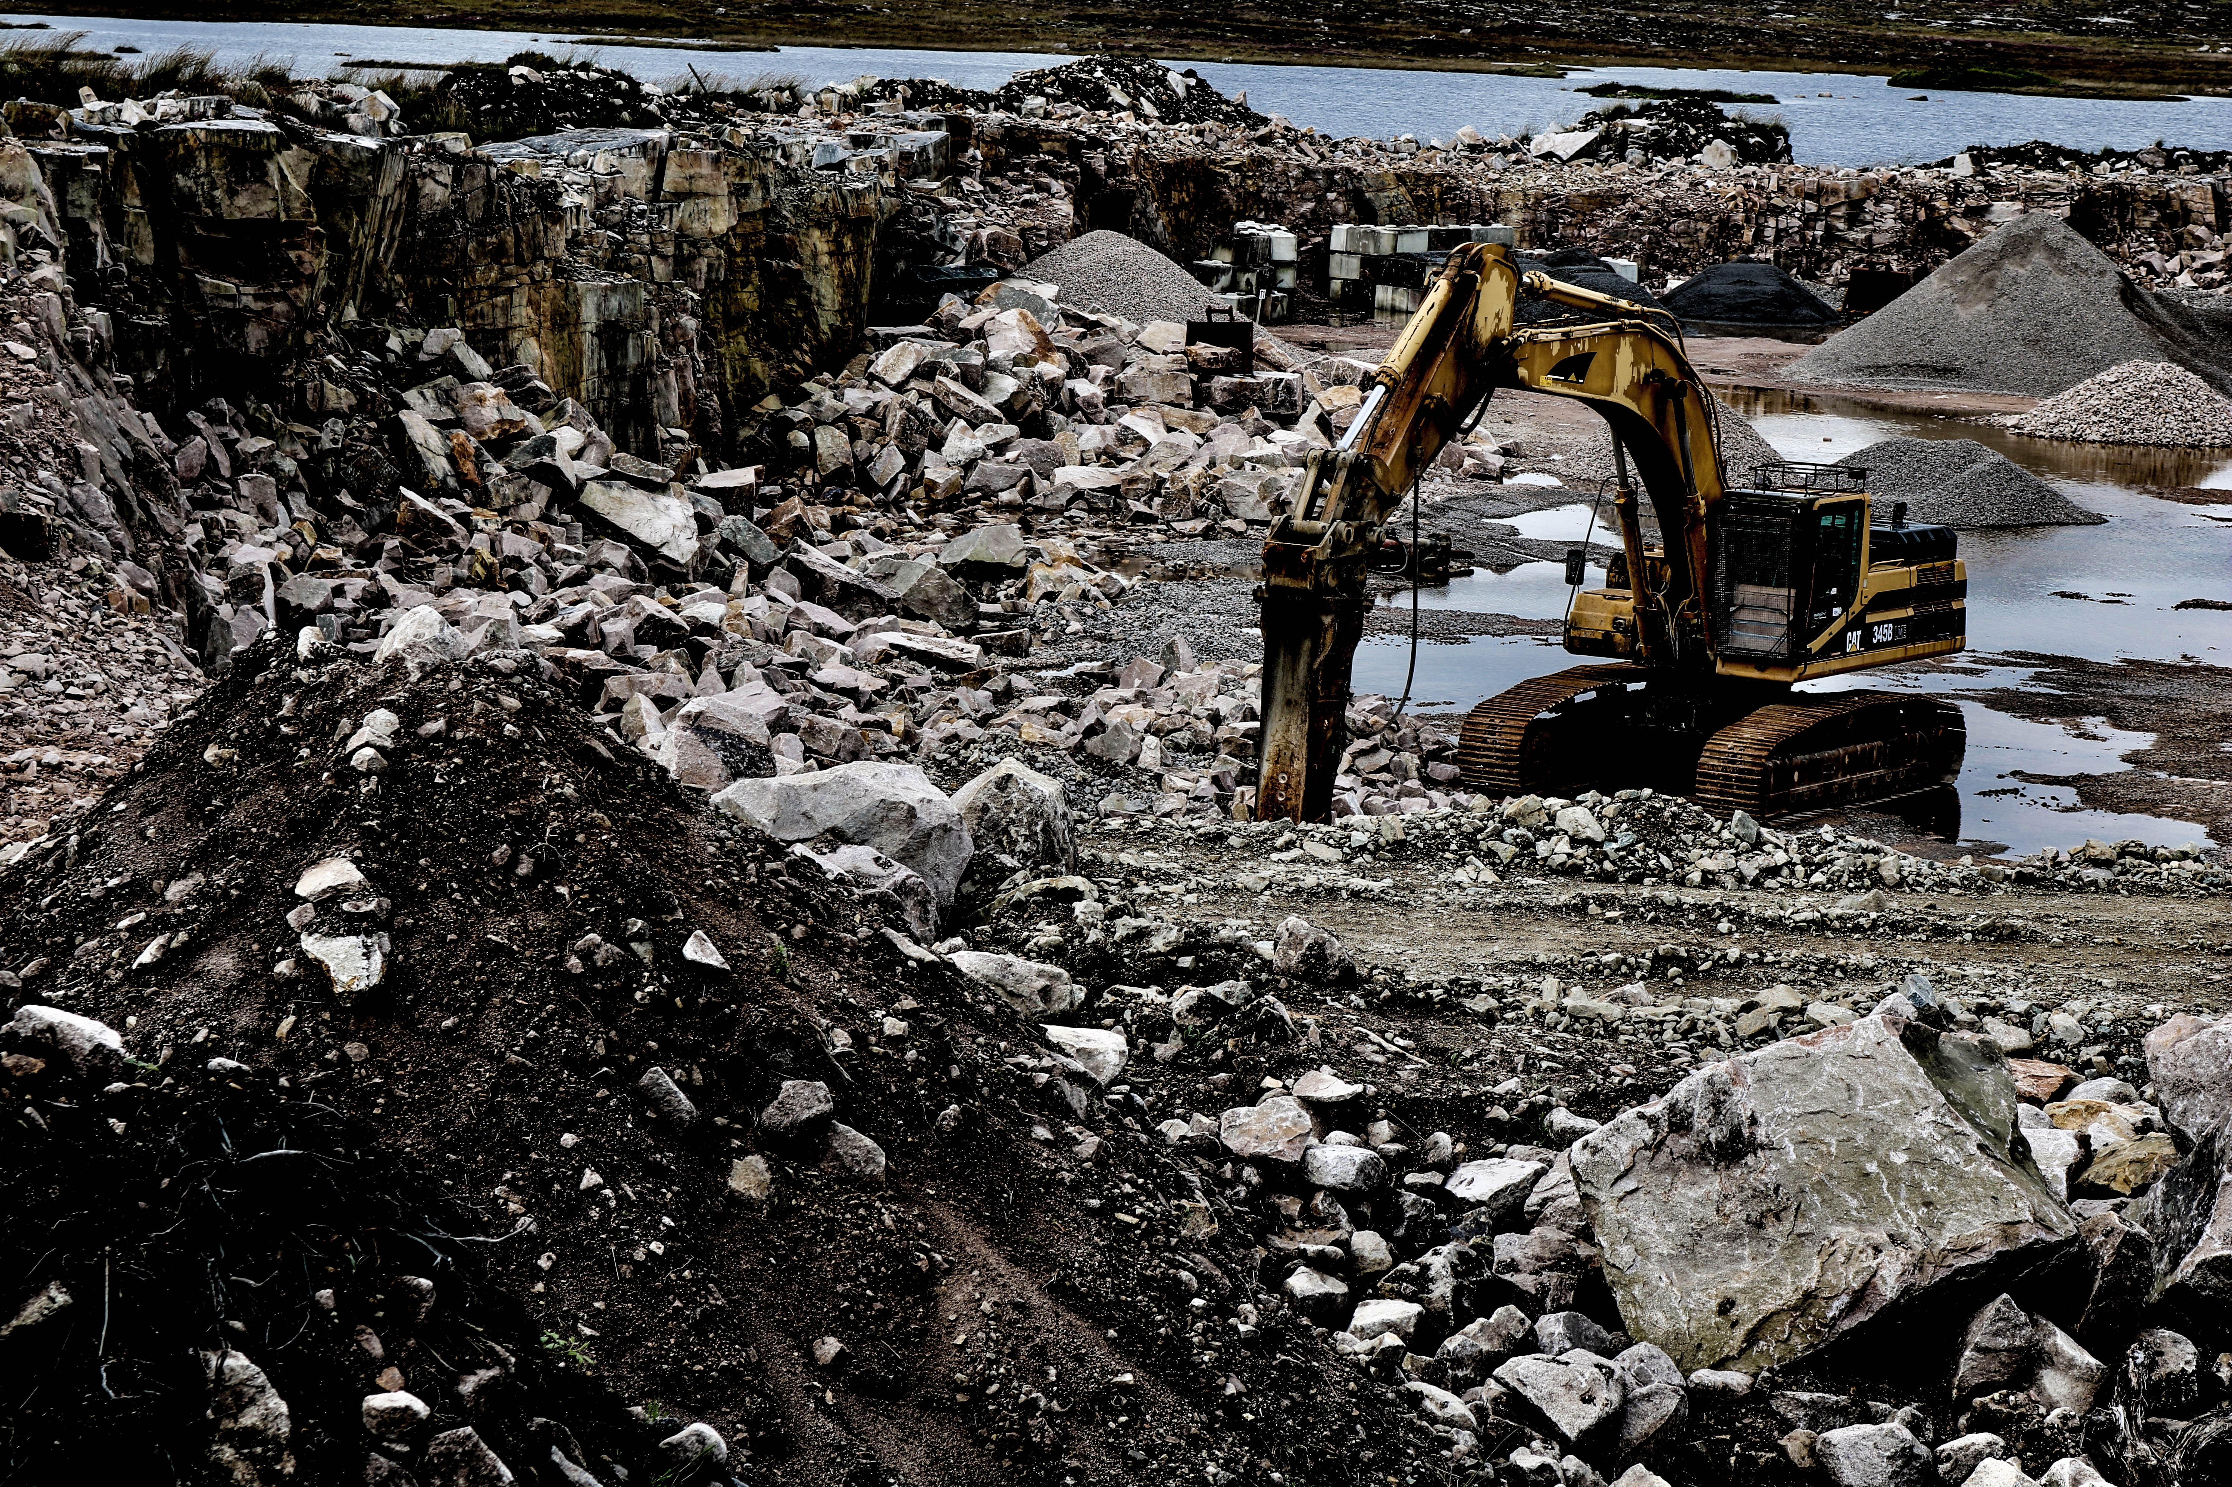

SLIIT ITP PROJECT PROPOSAL

Slide 2
METAL CRUSHER MANAGEMENT SYSTEM HERATH METAL CRUSHER
PROJECT ID - ITP21F_05
SUPERVISOR -

Slide 3
DETAILS OF PROJECT MEMBERS
Ravinda Anjana S.A.D - IT20062538
Dakumpitiya D.A.L.C - IT20187200
Bandara S.A.C.J.W - IT20197278
Wijesinghe W.A.K.R - IT20751296
Nigamuni M.M.S - IT20189426
Kadigamuwa A.S.T.W.M.R.R.W - IT20197100
Mithsara K.A.G.N - IT20190170
Ariyathilake H.L - IT20245788

Slide 4
Introduction

Slide 5
Problem Specification

Slide 6
Solution Outline

Slide 7
Key Benefits

Slide 8
System Overview

Slide 9
System Functions

Slide 10
Vehicle Repairing, Workload and Maintenance Management of Vehicles

Slide 11
Metal Crusher Machines Repairing, Workload and Maintenance Management

Slide 12
Loader Machines Repairing, Workload and Maintenance Management

Slide 13
Generator Machines Repairing, Workload and Maintenance Management and Sales Management

Slide 14
Administrative Tasks and Employee Attendance Management

Slide 15
Hammer, Compressor Machines Repairing, Workload and Maintenance Management

Slide 16
Excavator Machines Repairing, Workload and Maintenance Management

Slide 17
Other Remaining Items in Stock Management

Slide 18
Other Remaining Items in Stock Management

Slide 19
Tools & Technologies

Slide 20
Conclusion

Slide 21
Thank You!

